Slide 1
Introduction to Data Science
Adwait Bhave

Slide 2
Lots of data
Data is all around.
There are 2.5 quintillion bytes of data created each day at our current pace.
Every minute of the day:
Search queries on google 24,00,000
Snapchat users share 527,760 photos
More than 120 professionals join LinkedIn
Users watch 4,146,600 YouTube videos
456,000 tweets are sent on Twitter
Instagram users post 46,740 photos
Notes:
Ref : https://www.forbes.com/sites/bernardmarr/2018/05/21/how-much-data-do-we-create-every-day-the-mind-blowing-stats-everyone-should-read/#15b2a01860ba

Slide 3
Big data
Volume : The size of the data
Velocity : Speed at which data moves in systems
Variety : Data in all formats.

Slide 4
What is Data Science?
Not all data is useful.
Not all data is relevant.
An area that manages, manipulates, extracts, and interprets knowledge from data.
Understanding data and art of asking good questions!

Slide 5
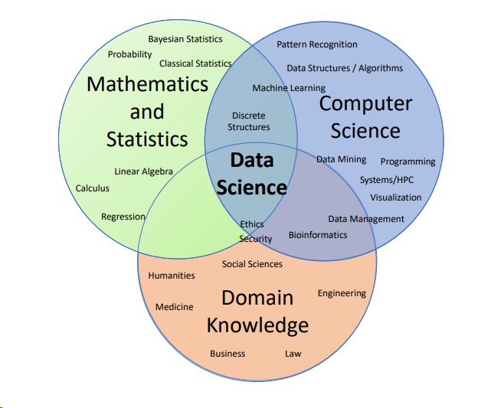
Data science
Notes:
Ref : https://www2.cs.duke.edu/courses/compsci190/fall18/notes/00-welcome.pdf

Slide 6
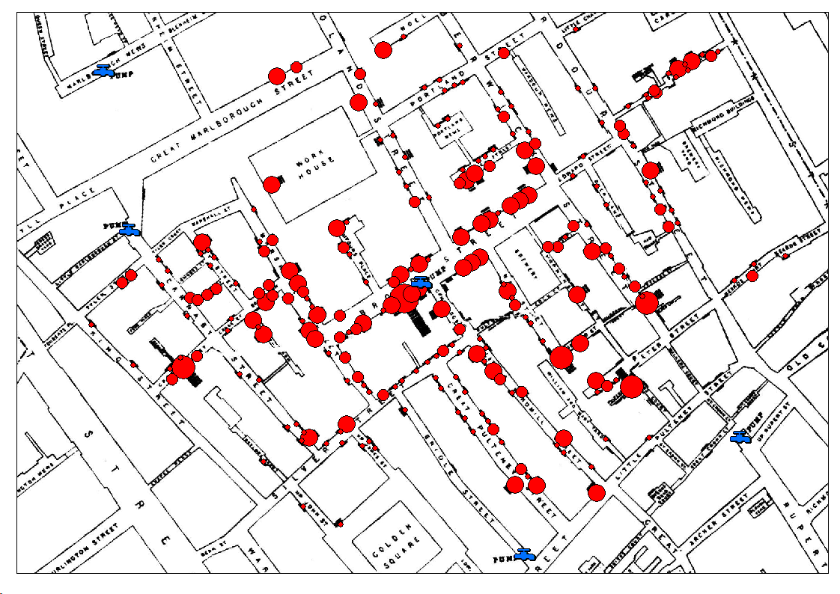
Real life stories (From 1854)
Notes:
Ref: https://en.wikipedia.org/wiki/John_Snow

Slide 7

Real life stories
Target identifies top products that are commonly bought in early pregnancy.
Uses purchase history to predict pregnancy, targets advertising for post-natal products.

Slide 8
About data scientist
Data scientists are the key to realizing the opportunities presented by big data. They bring structure to it, find compelling patterns in it, and advise executives on the implications for products, processes, and decisions.

Slide 9
Data science Process
Question / Problem
Data Problem
Collection
Cleaning
Processing
Exploratory
Analysis
Hypothesis
Tests & analysis
Insights
Programming, Mathematical Intuition, Stats mindset, modelling, Visualization

Slide 10
“I never guess. It is a capital mistake to theorize before one has data.
Insensibly one begins to twist facts to suit theories, instead of theories to suit facts.”
Sherlock Holmes

